Slide 1
CineNest.ai
AI POWERED INTEGRATED FILM PRODUCTION SYSTEM

Slide 2
Team members
Muhammed Fahad E V
Adhil Rifayin k s
Abhinav p
Deethu p

Slide 3
Introduction
Problem
Statements
Current Reality
Features
Impact
Workflow Automation
Conclusion
Table of Contents

Slide 4
Introduction-
Film making is an art , and making films take contributions from hundreds of people
The film industry has always been driven by creativity, but behind every scene lies a complex web of planning, logistics, and coordination.
Today, many production teams still rely on fragmented tools and manual workflows — leading to delays, miscommunication, and budget overruns.
CineNest.ai is here to change that.
5

Slide 5
Problem Statements
Pre Production
Production
Post Production
Script breakdown
Scheduling
Scouting
Crew Assignment
On-set coordination
Updates
Budget tracking
Distribution Monitoring
Investor updates

Slide 6
Current Reality
Miscommunication (crew misses updates)
Overspending (no real-time budget control)
Zero Transparency (producers & investors blind until late)
Technical Limitations

Slide 7
CineNest.ai Features
Your AI Production Assistant
Pre-Production Automation: AI script breakdowning, Scheduling,Location Scouting, crew assignment
On-Set Operations: crew coordination, schedules, notifications
Real-time production status updates
Budget Tracking,Budget analysis
Distribution: ticket sales
Status logs: daily update
Ai booking for locations
Legal advisor
Reports to investors

Slide 8
Core Ai Features
AI-Powered Pre-Production Suitt
Script Breakdown: Identifies characters, locations, and props automatically.
Location Scout: Suggests real-world shooting locations with images and maps.
Crew Suggester: Finds potential team members for open roles.
Budget Estimator: Calculates costs for props and equipment from the script.
Interactive Production Dashboards
Centralized view of all production data.
Editable AI-generated results.
Real-time updates for schedules, crew lists, and locations.
Comprehensive Financial Management
Track expenses and transactions in real time.
Visual charts for spending by category.
Investor dashboard: budget vs. actuals and ROI projections.
Automated Legal & Contracts
Contract Generator: Creates crew and location agreements.
Legal Advisor: AI-powered guidance on Indian film laws and compliance.
Seamless Collaboration
Centralized hub for planning and documentation.
Daily production logs stored securely in Firestore.

Slide 9
Tech stack
Frontend: Next.js 15, React, TypeScript
Styling: Tailwind CSS & ShadCN UI
Generative AI: Google's Genkit & Gemini Models
Backend & Database: Firebase (Authentication & Firestore)
Deployment: Firebase App Hosting for scalable and secure cloud deployment.

Slide 10
IMPACT
Efficiency: Drastically reduces the time spent on manual pre-production tasks.
Cost Savings: Provides early budget estimates and helps optimize spending.
Data-Driven Decisions: Empowers filmmakers with actionable insights from their own production data.
Transparency: Offers a single source of truth for all stakeholders, from the crew to investors.

Slide 11

Workflow Automation

Slide 12
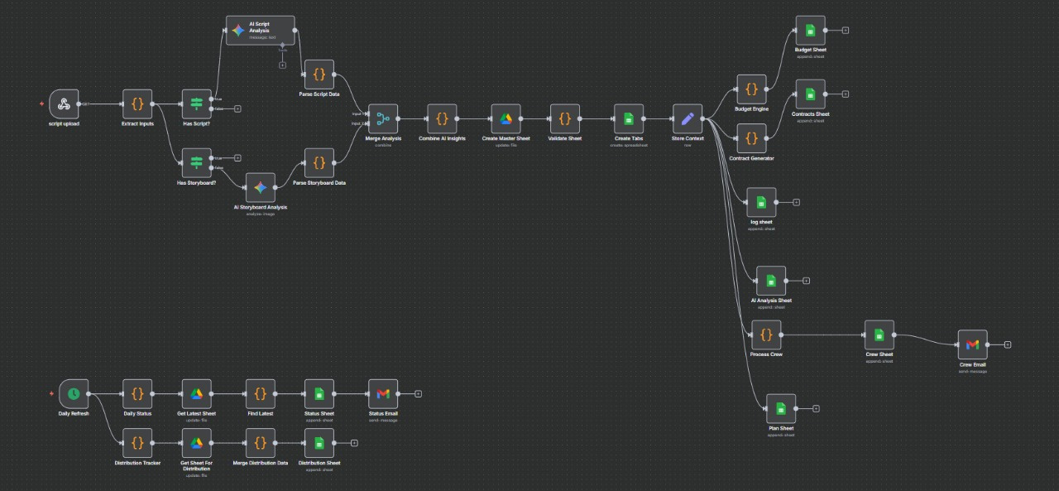

Slide 13
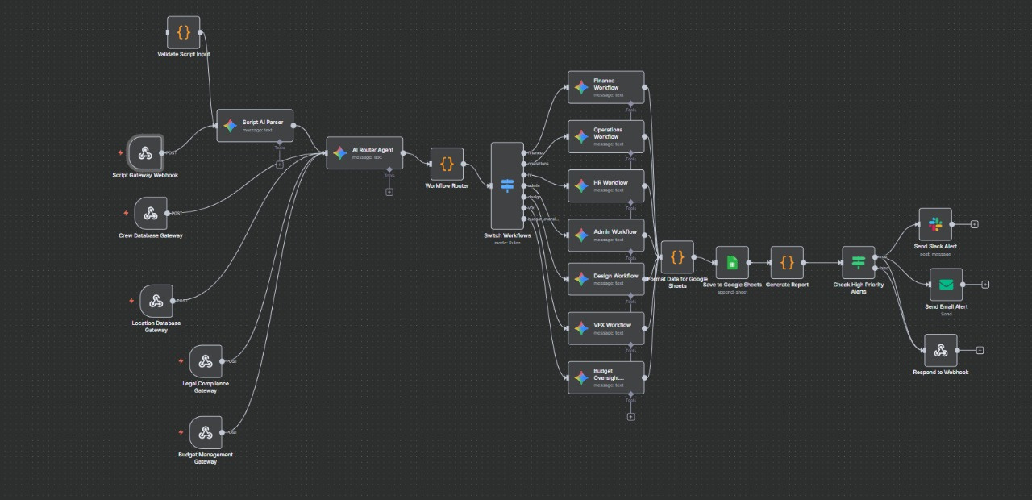

Slide 14
CONCLUSION
Transforming film making into a fully automated , transparent and efficient working environment

Slide 15

The End
THANK YOU FOR LISTENING

